Slide 1
Contemporary Tourism
Contemporary Tourism Marketing

Slide 2
Lecture Objectives
Be aware of the scope and definition of contemporary tourism marketing
Be familiar with the evolution of marketing focus from goods to services
Understand the nature and dimensions of the contemporary tourism marketing environment
Appreciate the need for tourism market information and the role of research
Recognise the central role of relationship marketing in contemporary tourism marketing
Understand that technology is transforming the practice of contemporary tourism marketing
Realise the importance of innovation and new product development in tourism
Be aware that corporate social responsibility and ethics will play a growing role in contemporary tourism marketing

Slide 3
Definitions
Trend to conceptualize tourism marketing as a services approach
Focus on customer needs
Reflects prevailing thinking of the time

Slide 4
Kotler’s Definition
A market is
‘A set of actual and potential buyers who might transact with a seller’. This market can be a physical or virtual space’ (Kotler et al, 2003, p 20).
Marketing is
‘A social and managerial process by which individuals and groups obtain what they need and want through creating and exchanging products and value with others’ (Kotler et al, 2003, p.12).

Slide 5
Kotler’s Definition
Based on:
Exchange
Identifying and meeting customer needs

Slide 6
Marketing Orientation
Unwavering focus on the customer
Based on exchange and long terms relationships
Planning
Delivering value
Organisational structures

Slide 7
Evolution of Marketing
Production orientation
Sales orientation
Marketing orientation
Societal and social marketing
Kotler’s ‘marketing 4.0’
Exchange principle
Services vs goods
Services as dominant marketing logic
Co-creation

Slide 8
Marketing Environment
Demanding empowered customer
Post tourist
Traditional models do not work
Globalizing markets
International is not global
Borderless world
Homogenous demand
Fragmenting markets

Slide 9
Marketing Environment
Connected knowledge economy
Networked economy
Tourism depends on collaboration
Adaptive organizations
Flexible organizations
Coalitions and exchange
Hubs of complex networks
Market exchange companies
Marketing coalition companies

Slide 10
Practice of Contemporary Tourism Marketing
Research driven market information
Knowledge management
Variety of information sources
Deep and meaningful research
Difficult in tourism due to product and the sector
Underpins decisions for new products and opportunities
Future lies in qualitative and technological approaches

Slide 11
Practice of Contemporary Tourism Marketing
Relationship marketing
Build relationships across the organization
Creating and enhancing strong relationships with the customer
Differs from transactional marketing
Strategies for customer binding

Slide 12
Practice of Contemporary Tourism Marketing
Technology
Influences every part of contemporary tourism marketing
Changed culture of purchasing
Connects all market actors
Reduces costs
E-marketing ideally suited to intangible nature of tourism

Slide 13
New Tourism Product Development
Vital for competitiveness
Responds to changing tastes and technology
Tourism has special conditions to be taken in to account
New products differ from new services
2 approaches
Stage gate
Step wise

Slide 14
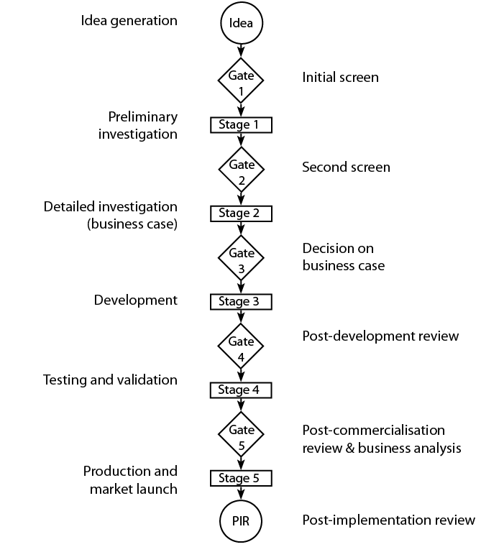
The Stage Gate Process Model

Slide 15
Corporate Social Responsibility
Driven by customer pressure
Takes into account broader needs of society
Ethical consumption growing in importance

Slide 16
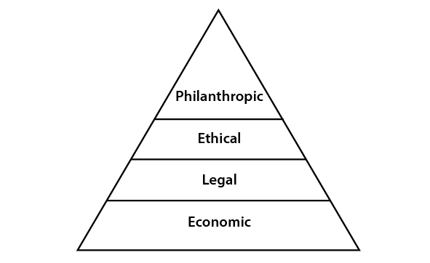
The CSR Pyramid

Slide 17
Green and Ethical Marketing
UNWTO Global Code of Ethics
Types of consumer
Deep ethics

